Slide 1

SOEN 6111 - BIG DATA ANALYTICS
GROUP - 41
CUSTOMER SEGMENTATION ANALYSIS AND PREDICTING SALES REVENUE USING BDA
Final Project Presentation

Slide 2
Group-41 Members
Vedasree Reddy Sapatapu | 40205481
Velagapudi Sri Neha | 40234170
Pramoda Martha | 40194182

Slide 3
TABLE OF CONTENTS
T
INTRODUCTION
DATASET OVERVIEW
DATA CLEANING & PRE-PROCESSING
EXPLORATORY DATA ANALYSIS
MACHINE LEARNING MODELS

Slide 4
RESEARCH QUESTIONS
RQ1- Can we predict which customers are likely to make repeat purchases for the next quarter?
RQ2- What customer behavioral patterns can be derived from the selected dataset?

Slide 5
DATASET OVERVIEW
Used Online Retails II dataset from the UCI Machine Learning Repository
Invoice No., Stock Code, Description, Quantity, InvoiceDate, UnitPrice, CustomerID, Country are the data attributes

Slide 6
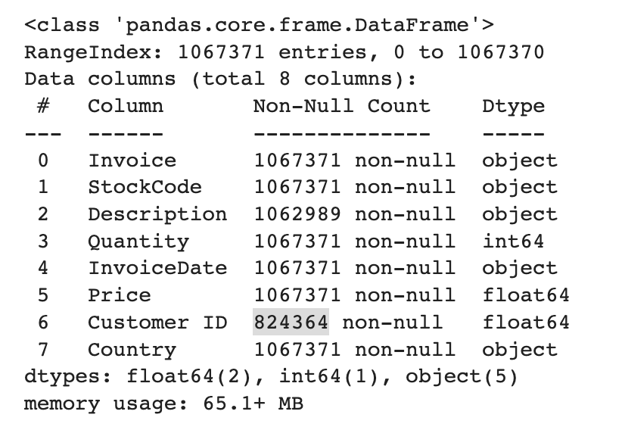
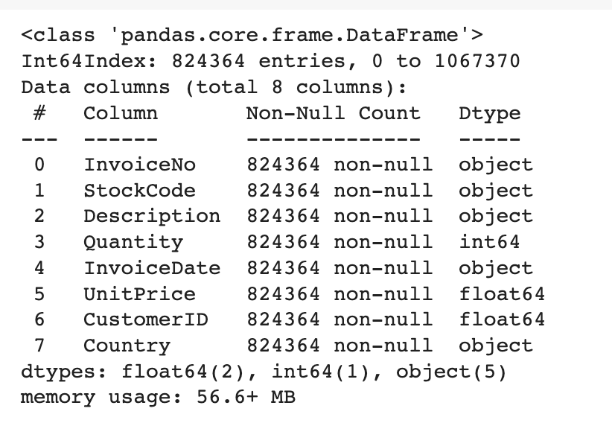
DATA CLEANING & PRE-PROCESSING
Dropped the rows that had the null values

Slide 7
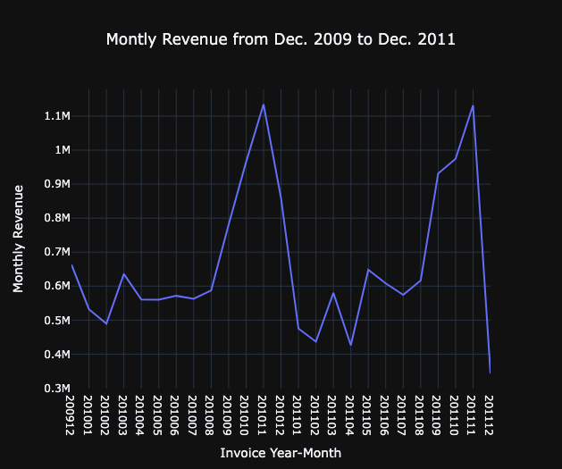
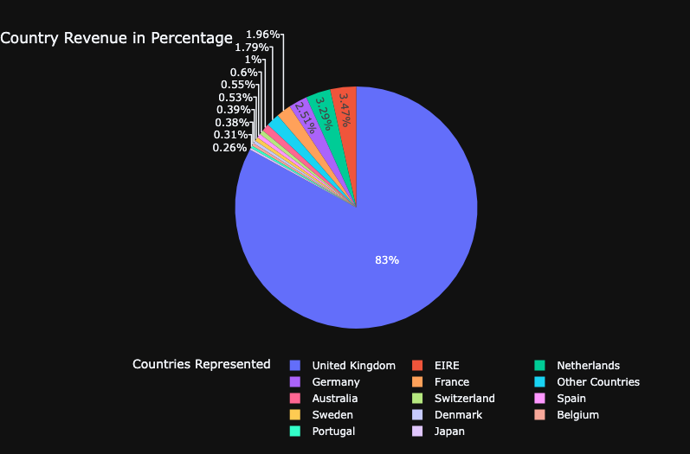
EXPLORATORY DATA ANALYSIS - 1

Slide 8
EXPLORATORY DATA ANALYSIS - 2
With the help of data analysis we wanted to know our best customers, big spenders, loyal customers.
To answer the above we have calculated Frequency, Revenue and Recency.
For the calculation of frequency, we counted the number of purchases made by each customer.
For the calculation of revenue, we have grouped the revenue generated from each purchase by the unique customer IDs.
In order to determine recency, we took into account each customer's first and last purchase dates and subtracted them to get the amount of days that a client has been inactive.

Slide 9
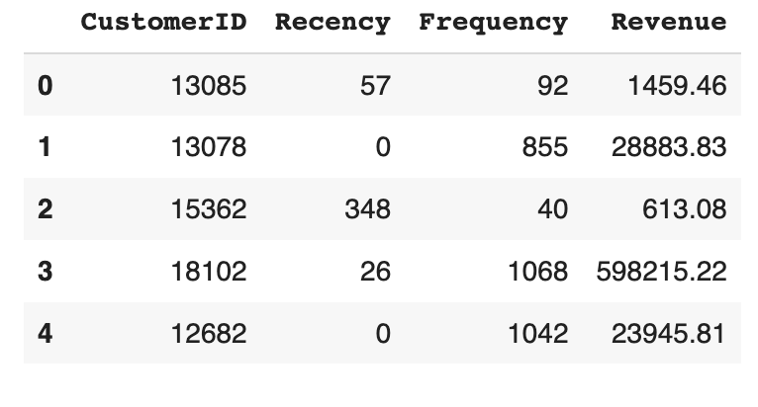
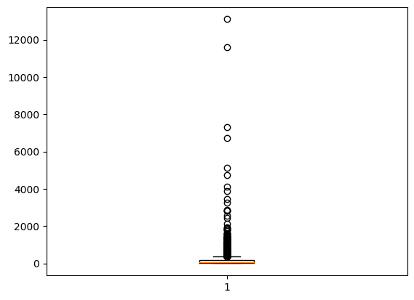
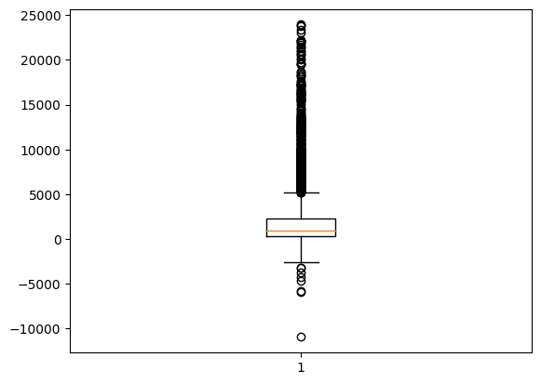
EXPLORATORY DATA ANALYSIS - 3
Revenue

Slide 10
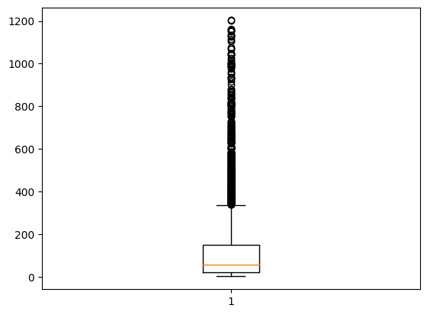
EXPLORATORY DATA ANALYSIS - 4
Frequency

Slide 11
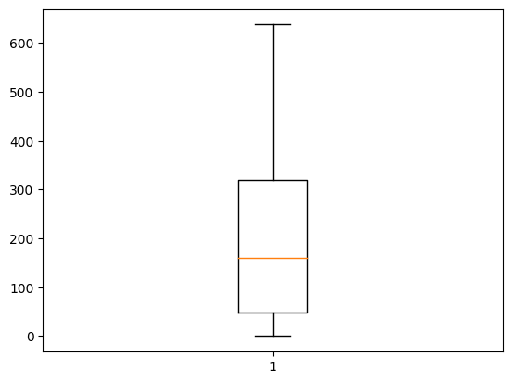
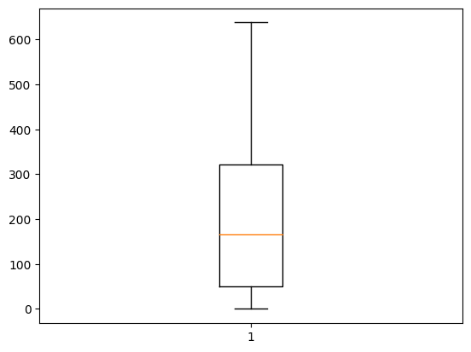
EXPLORATORY DATA ANALYSIS - 5
Recency

Slide 12
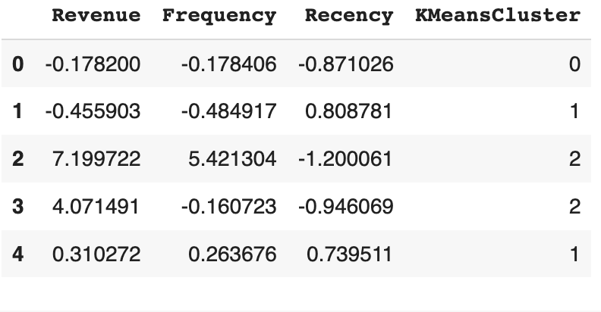
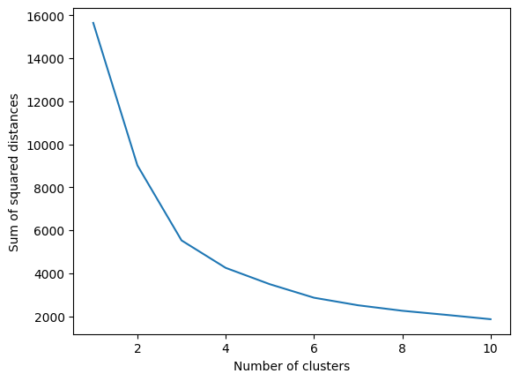
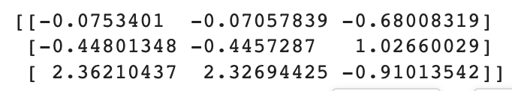
EXPLORATORY DATA ANALYSIS - 6
For transforming the data in to an appropriate range, we have used Standard Scaler to scale the data with the three scores.
Accuracy of 96% was observed when we used Hopkins Statistic as a metric, to check whether the data can be clustered or not.
For answering RQ2, the data is loaded in to K-Means clustering algorithm.

Slide 13
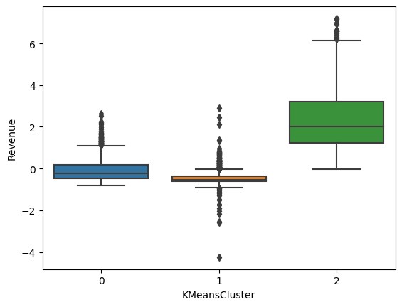
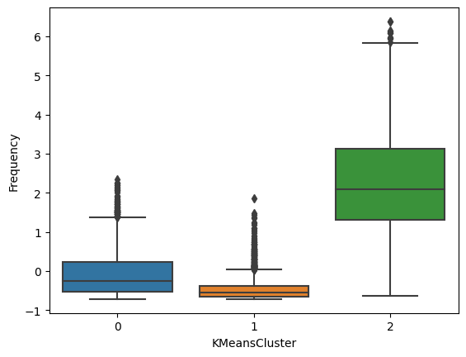
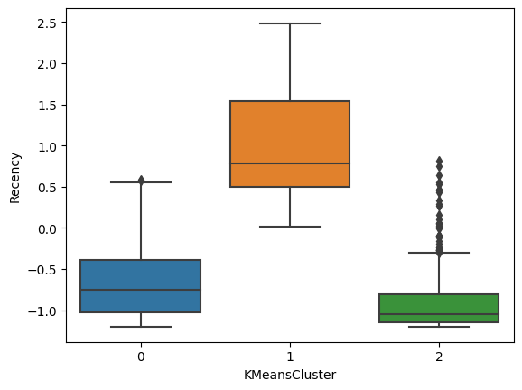
EXPLORATORY DATA ANALYSIS - 7

Slide 14
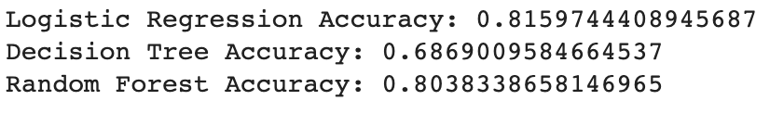
MACHINE LEARNING MODELS-1
As an answer to RQ1, we have built a machine learning model that can predict the customers’ chance of making a purchase in the next quarter.
The highest accuracy is shown by Logistic Regression when compared with Decision Tree and Random Forest classification algorithms.

Slide 15
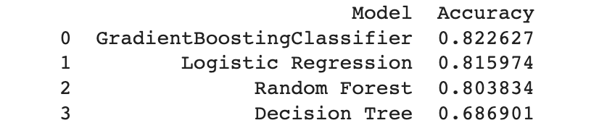
MACHINE LEARNING MODELS-2
For the same RQ1 , we used hyperparameter tuning, for that we used GridSearchCV to find the best hyper parameters and then it is loaded into the Gradient Boost algorithm.
The accuracy obtained with the above algorithm is approx. 83%

Slide 16


